Slide 1



Corona Virus Analysis Using SQL
Presenter Name: Niveditha K O
Profile : Data Analyst Intern

Slide 2

Overview
The COVID-19 pandemic is a global health crisis affecting millions worldwide.
Data analysis plays a crucial role in understanding the spread, identifying trends, and informing public health decision.
This task demonstrates basic SQL syntax and statement skills
Using SQL, we will examine key pandemic aspects and provide insights into its impact
Findings will be presented with clear explanations and data visualization.
2

Slide 3

Introduction
In my capacity as a Data Analyst intern at Mentorness Organization, I embarked on a compelling journey of unravelling the profound impact of the COVID-19 pandemic, Spanning from jan 22,2020, to June 13, 2021, our analysis delved into a vast dataset comprising 78,386 meticulously curated entries, documenting the pandemic’s ramifications across diverse provinces and countries worldwide.
Through rigorous SQL analysis, we meticulously scrutinized this wealth of data, unearthing nuanced insights and trends that illuminate the intricate dynamics of the pandemics spread and management.
This presentation marks the culmination of our collective efforts- a testament to our dedication to precision, insights, and the relentless pursuit of data-driven solution. Join us as unveil the findings of our journey through the COVID-19 data analysis.
3

Slide 4
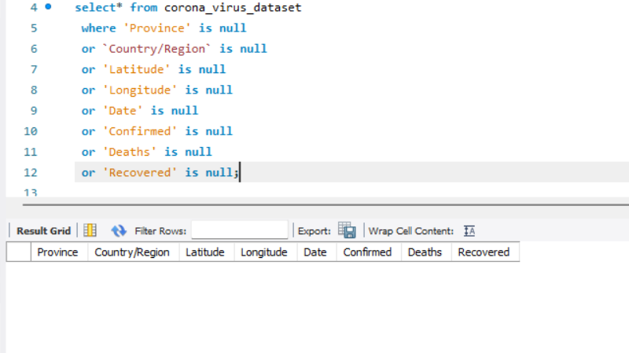
Write a code to check Null values
4

Slide 5
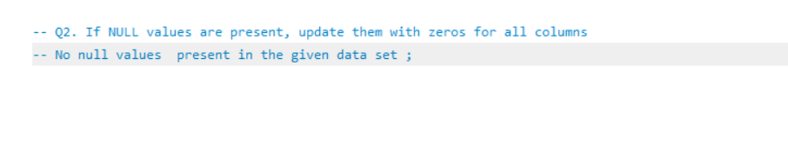
If null values are present, update them with zeroes for all columns
5

Slide 6
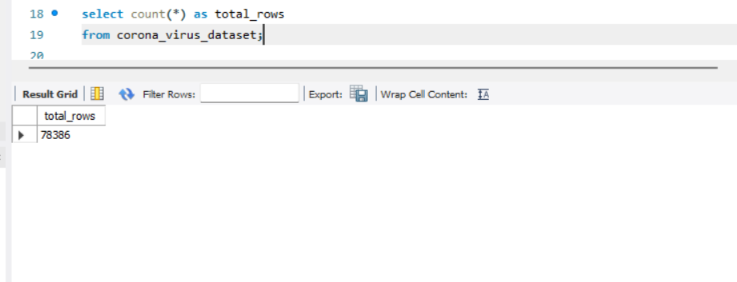
Check total number of rows

Slide 7
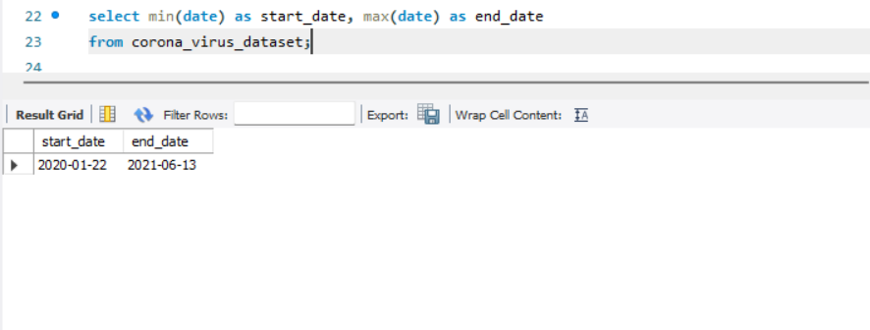
Check what is start date and end date of the pandemic

Slide 8
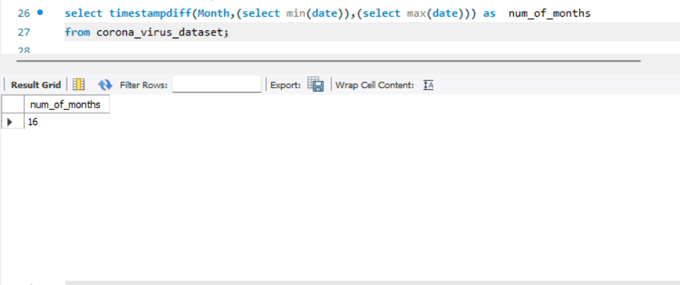
Number of month present in dataset

Slide 9
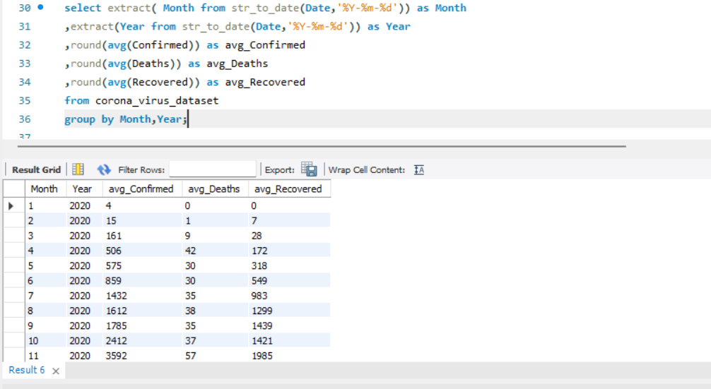
Find monthly average for confirmed, deaths, recovered

Slide 10
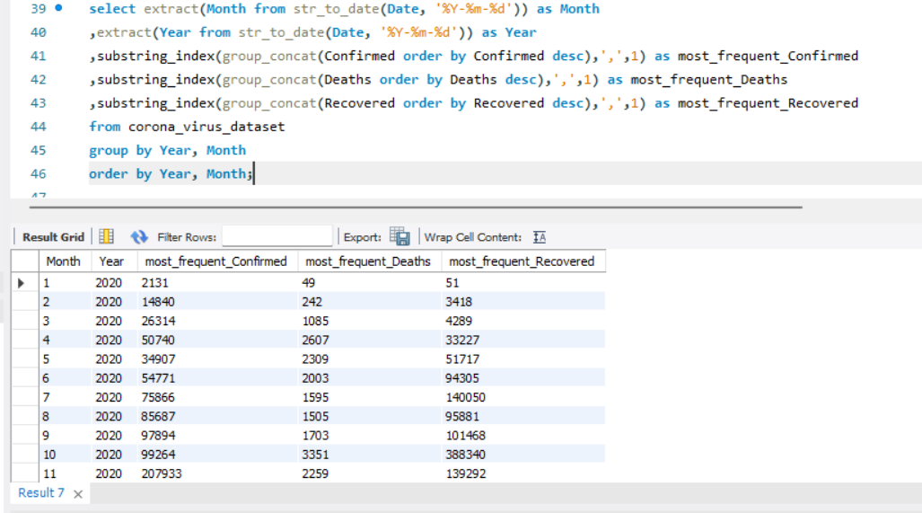
Find most frequent value for confirmed , deaths, recovered each month

Slide 11
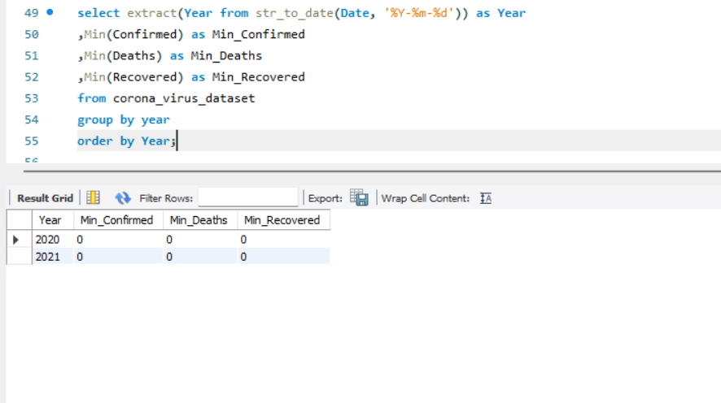
Find minimum values for confirmed, deaths, recovered per year

Slide 12
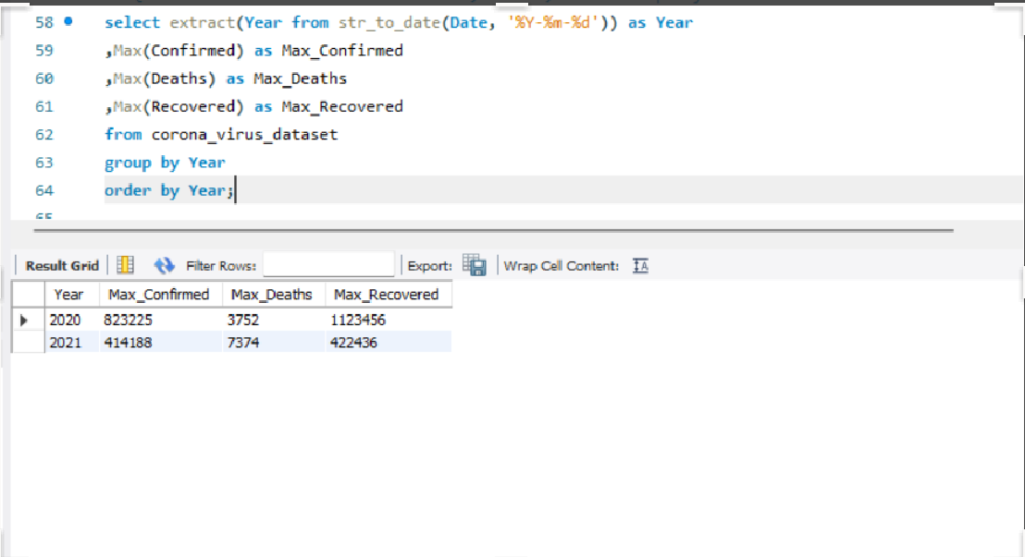
Find maximum values of confirmed, deaths, recovered per year

Slide 13
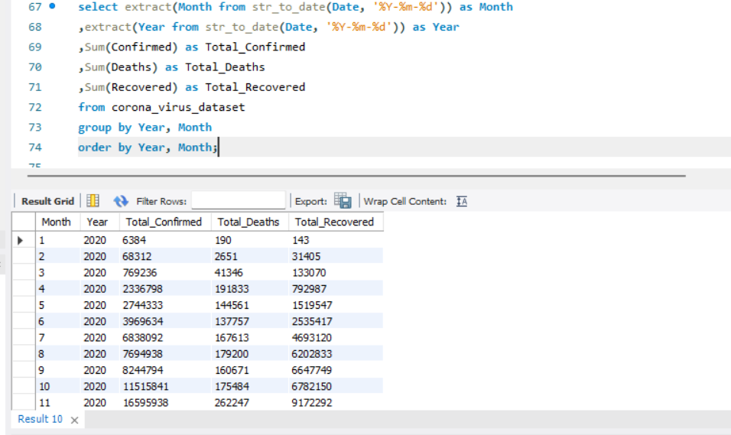
The total number of case of confirmed, deaths, recovered each month

Slide 14
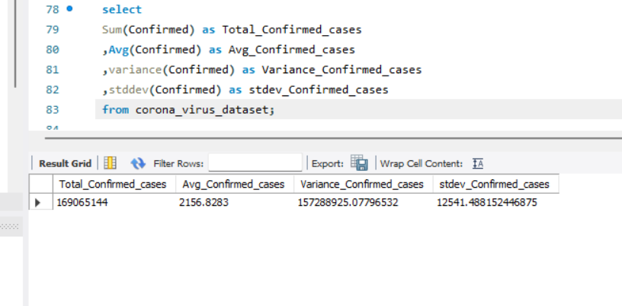
Check how corona virus spread out with respect to confirmed case Eg.: total confirmed cases, their average, variance & STDEV

Slide 15
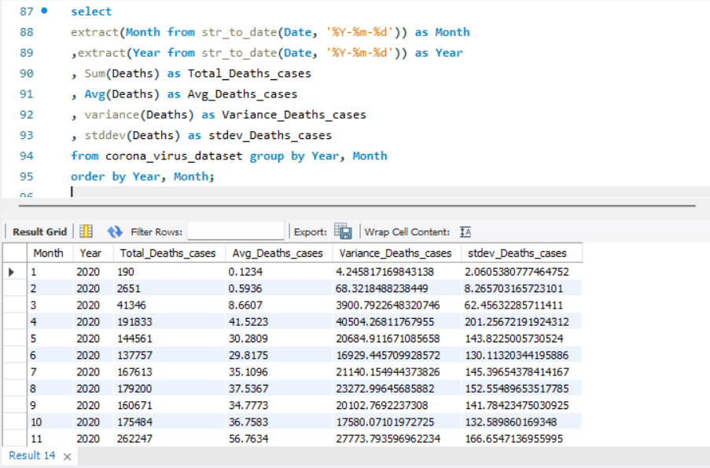
Check how corona virus spread out with respect to death case per month (Eg.: total confirmed cases, their average, variance & STDEV )

Slide 16
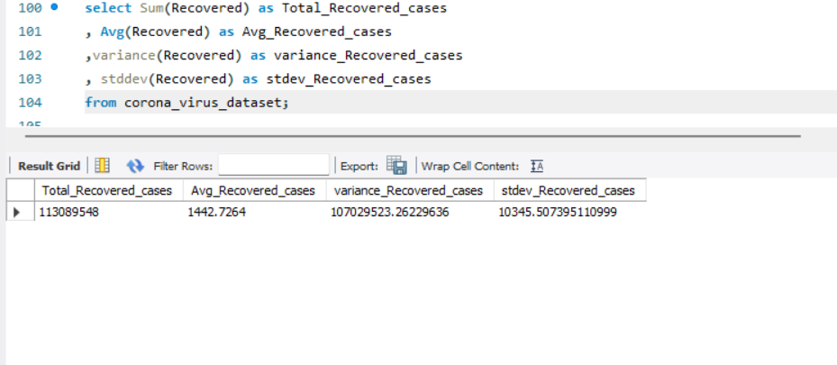
Check how corona virus spread out with respect to recovered case (Eg.: total confirmed cases, their average, variance & STDEV )

Slide 17
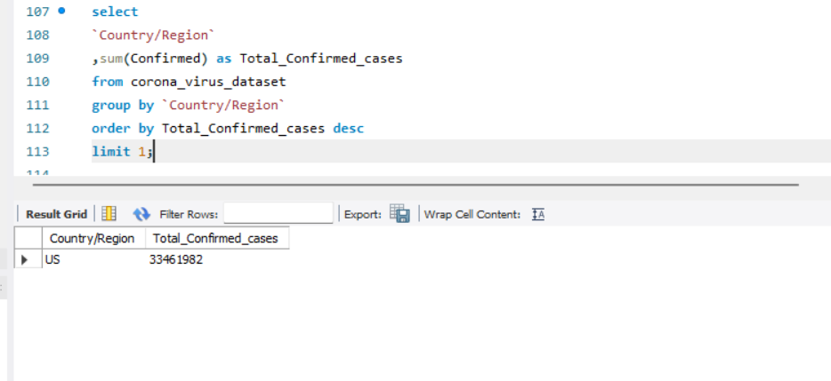
Find Country having highest number of the Confirmed case

Slide 18
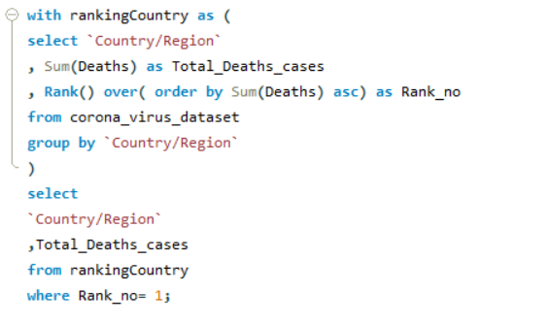
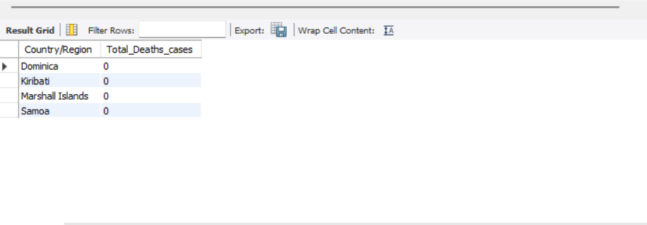
Find Country having lowest number of the death case

Slide 19
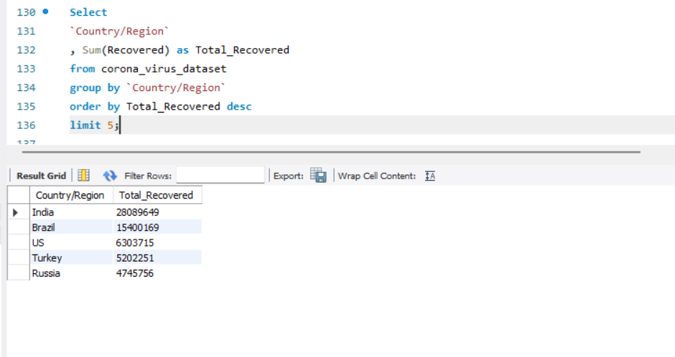
Find top 5 countries having highest recovered case

Slide 20


Conclusion
Our analysis of the COVID-19 dataset revealed key trend, pattern and country-wise difference in case, deaths, and recoveries.
Data quality, completeness, and consistency are crucial for understanding the pandemic’s spread and impact.
Data analysis informs public health decision and strategies to combat the virus
Date-drive decision-making is essential for building a healthier, safer future

Slide 21

Thank you

